Slide 1
Information Manipulation by Social Media Bots through a Network Analysis View
Lynnette Hui Xian Ng
Carnegie Mellon University
Societal Computing, School of Computer Science
Notes:
Good afternoon everyone! Thank you for the invite. It is an honour to be here today and talk about Information Manipulation by Social Media Bots through a Network Analysis View.
My name is Lynnette, and I am a PhD Candidate at Carnegie Mellon University’s School of Computer Science, in the Societal Computing program.
I study the influence of human behaviour in social media using computational methods. Why social media?

Slide 2
Notes:
Because my generation, and the generations to come will interact with other humans on a daily basis through our online feeds with our phones, iPads and laptops.
We broadcast our travel destinations on Instagram, watch Taylor Swift’s concert snippets on TikTok, and find our partners from dating apps.

Slide 3
Influencing People
Notes:
Now, what about influencing human behaviour? Influence, is not a new concept. Humans have been influenced, and is continuing to be influenced, by advertisements for a long time. Remember the mouthwatering advertisements on the SBS buses that made every school student want to buy their chicken nuggets?

Slide 4
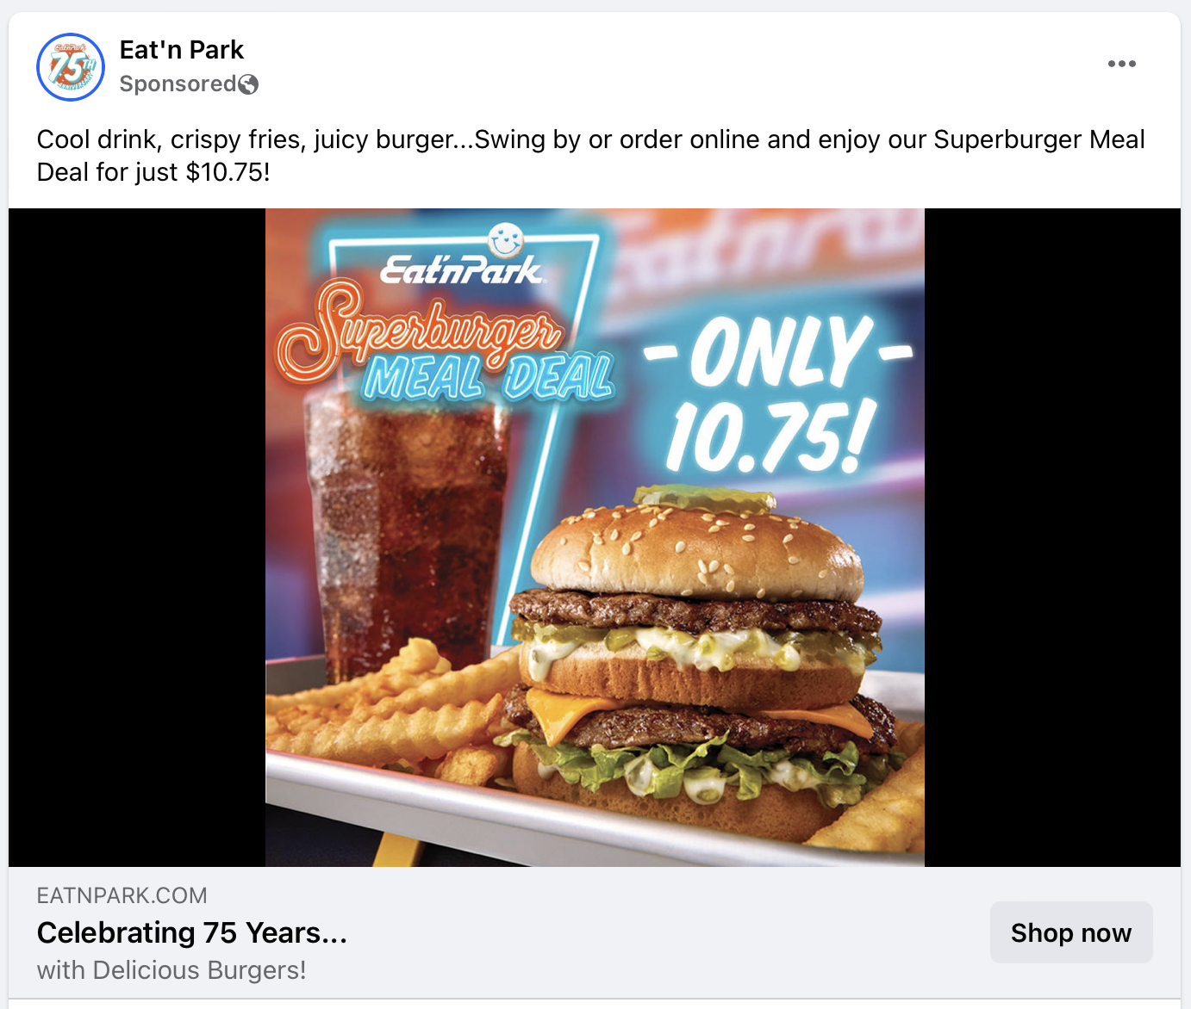
Influencing People
Notes:
Today, the fast food advertisement still exists, only it has moved to Facebook.

Slide 5
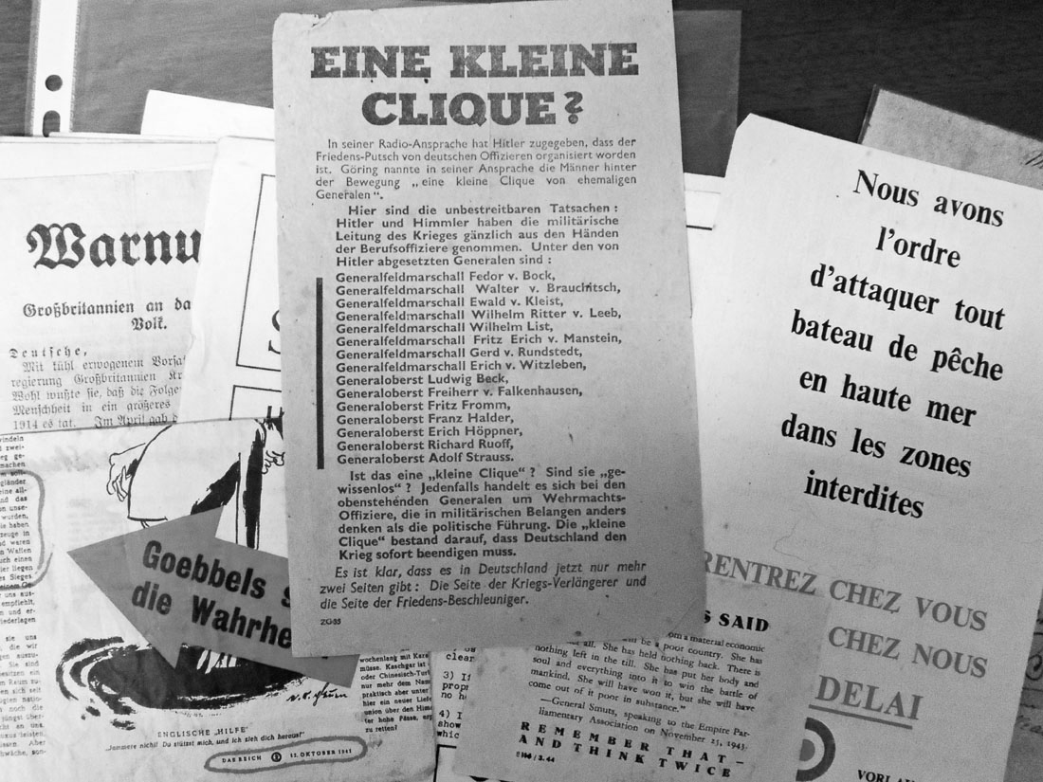
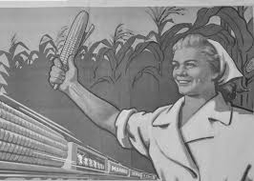
Information Manipulation Persuasion
Notes:
Today, we’re going to talk about Information Manipulation. At its heart, Information manipulation is persuasion. The Cold War saw leaflets and posters pulling at emotional heartstrings, instilling fear and patriotism, scattered across the streets, persuading the common folk with personal captions like “You can make a difference, the soldiers are counting on you”.
Persuasion allows for mind control, which provides the persons forming the narratives power over the population.

Slide 6
Social media for information manipulation Reach global audiences Micro-target Construct multimodal messages
Notes:
Disseminating information online is an extremely powerful technique. The online ecosystem provides a platform to reach global audiences with single messages, to micro- target for select audiences, and to construct multimodal messages designed to tug at the heart.

Slide 7
Automated Entities
Create posts at specified periods of time
Target posts to specific audience
Act on posts by heuristics
Social Media Bots
Notes:
Disseminating information online more often than not makes use of automated entities called social media bots. Bots are automated entities that create posts at specified periods of time, can target posts to specific audiences, and can act on posts by heuristics. To that end, I have profiled and developed detection algorithms of a variety of bot types, in what I call the BotBuster Universe.

Slide 8
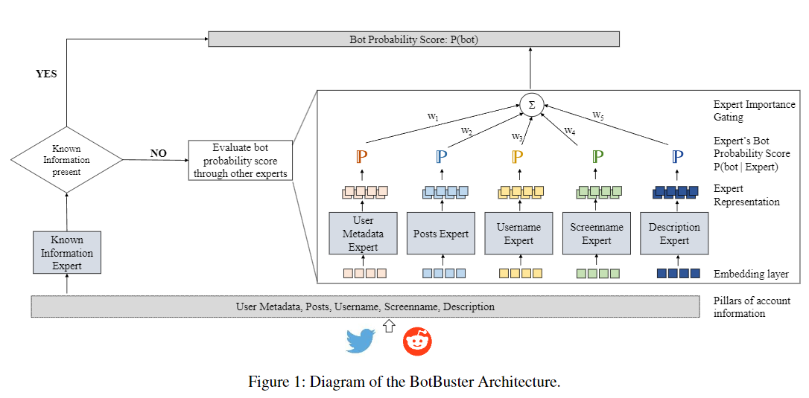
BotBuster Detection Algorithm
Mixture of Experts algorithm aggregating prediction probabilities per data pillar
Social Media Bots
“BotBuster: Multi-platform Bot Detection using Mixture of Experts” AAAI ICWSM
Notes:
At the core of the BotBuster Universe, is the BotBuster detection algorithm. This algorithm is used to identify users that are likely to be bots. This algorithm uses a mixture of experts architecture to aggregate prediction probabilities from predicting a part of the data. The Parts of the data are: user metadata, post, username, screen name and description.
(Avg score 72% accuracy for the original; 98% for the latest version)

Slide 9
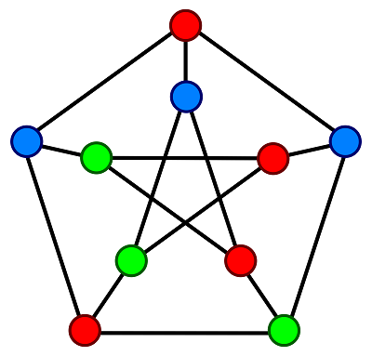
Quick Primer on Networks
Notes:
Here we got into a quick interlude to describe networks, and network science. Network science largely intersects with graph theory. Let’s imagine this graph to be a network.

Slide 10
Quick Primer on Networks
Node
Users
Node Colour = Type of User
Bot/Human
Notes:
In a typical social network analysis, a node is visually represented by a circle. This node symbolises the users. The node colour symbolises the type of user. Within this talk, bots and humans have different colours.

Slide 11
Quick Primer on Networks
Node
Users
Node Colour = Type of User
Bot/Human
Node Size =
Centrality of User
Influence, Access, Control of Flows
Notes:
The node size indicates the centrality of the user. Centrality includes metrics that indicate the user’s influence, access to other users, and the control of information flow within the network. Typically, the larger the node, the higher the centrality.

Slide 12
Quick Primer on Networks
Node
Users
Node Colour = Type of User
Bot/Human
Node Size =
Centrality of User
Influence, Access, Control of Flows
Links = Connection between Nodes
Communication
Notes:
Links indicate connection between nodes. In this talk, when links between two nodes signify communication between the two users, which could be in the form of one user retweeting or replying the other users’ posts.

Slide 13
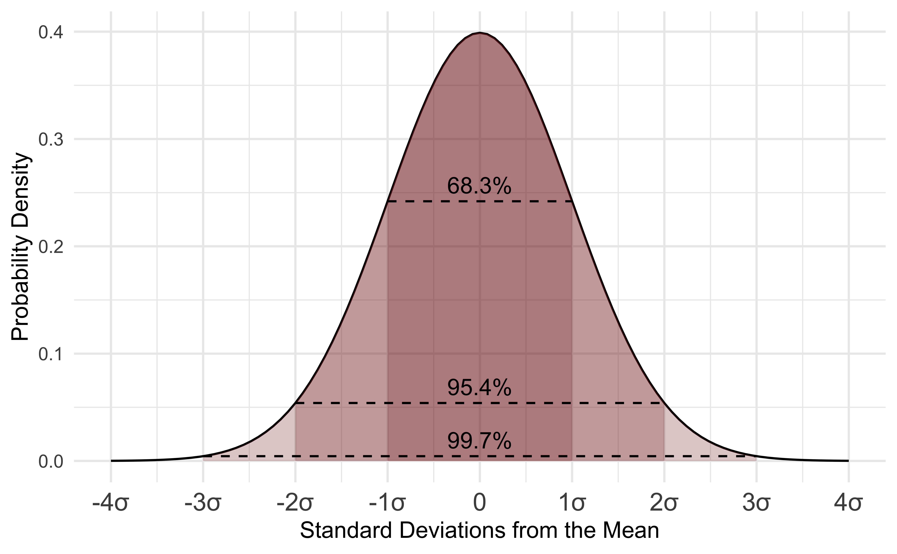
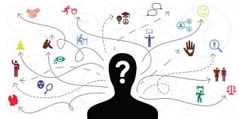
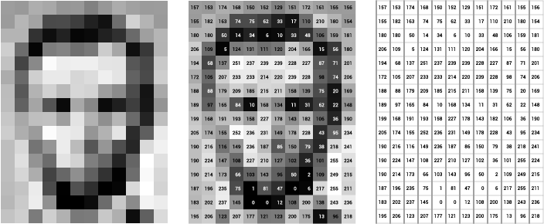
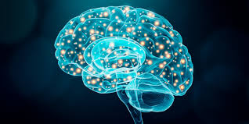
Intersecting Disciplines
Statistics
Social Psychology
Computer Vision
Cognitive Science
Natural Language Processing
Behavioural Economics
Notes:
Intersecting disciplines to societal computing includes social disciplines and computing disciplines. In computing disciplines we have statistics, computer vision, natural language processing and so forth. Social disciplines include social psychology, cognitive science, behavioural economics and so forth.

Slide 14
Information Manipulation Persuasion
WHO, WHAT, WHEN, WHERE, WHY, HOW
Notes:
Now, let’s return to the topic of this talk: Information Manipulation. I will talk about Information Manipulation in terms of the 6W1H frame: Who What When Where Why How.

Slide 15
Information Manipulation Why do we care?
Notes:
First, let’s talk about the Why. Why do we care about information manipulation?

Slide 16
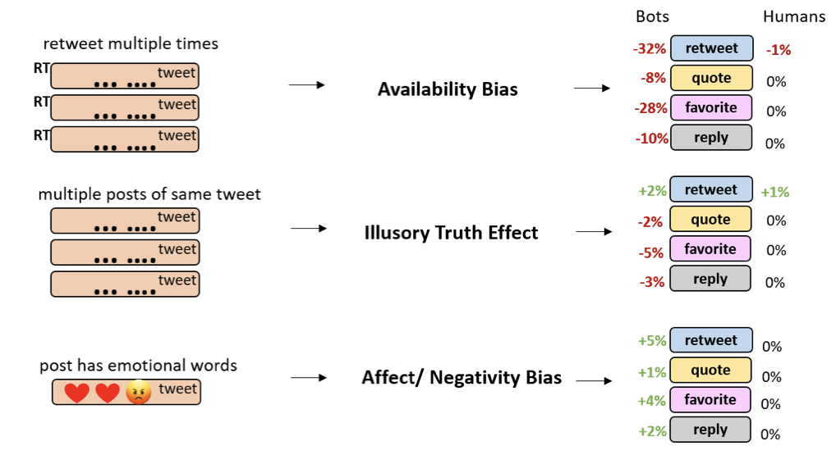
Information Manipulation Why do we care?
Create Engagement
“Exploring Cognitive Bias Triggers in Disinformation Tweets: A Bot and Human Perspective”
Notes:
We care because information manipulation, especially through triggering cognitive biases, can manipulate engagement.
For example, playing on emotions by using the Affect or negativity bias can increase the engagement of a post.
In contrast, using the availability bias, which repeats a narrative multiple times can reduce the engagement towards a post, because it seems like incessant nagging.

Slide 17
Information Manipulation Why do we care?
Create Engagement
Manipulating engagement changes visibility of posts
“Exploring Cognitive Bias Triggers in Disinformation Tweets: A Bot and Human Perspective”
Notes:
Manipulating engagement can change the visibility of the post, and therefore the narrative, especially with social media recommendation algorithms that push more engaged posts and narratives to the top of the recommended feed.

Slide 18
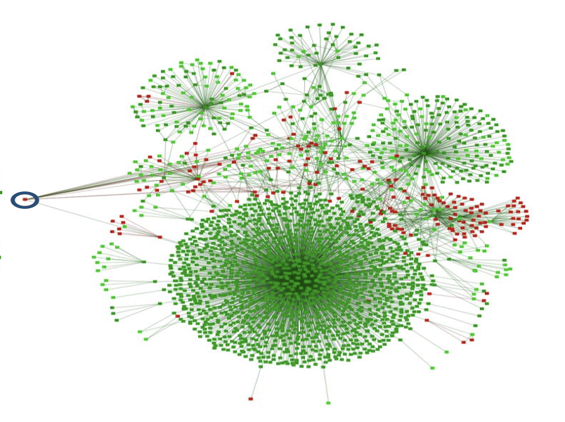
Information Manipulation Why do we care?
Changing people stances
“Pro or Anti, A Social Influence Model of Online Stance Flipping” IEEE Transactions of Network Science and Engineering
Green = Pro-Vaccine Users / Red = Anti-Vaccine Users
Notes:
Another reason why we care is because information manipulation can change people’s stances.
A study of stances that people expressed throughout the COVID-19 vaccine period show that information manipulation can change people’s stances. We studied people’s expressed stances with a year-long longitudinal study. In this image, green nodes represent pro-vaccine users; and red nodes represent anti-vaccine users. The node in the circle is originally an anti-vaccine user. However, after a few timeframes, the circled node change its stance to pro-vaccine.

Slide 19
Information Manipulation Why do we care?
Changing people stances
If you apply enough social pressure, people change their stances
“Pro or Anti, A Social Influence Model of Online Stance Flipping” IEEE Transactions of Network Science and Engineering
Green = Pro-Vaccine Users / Red = Anti-Vaccine Users
Notes:
This shows that if you apply enough social pressure, people change their stances.

Slide 20
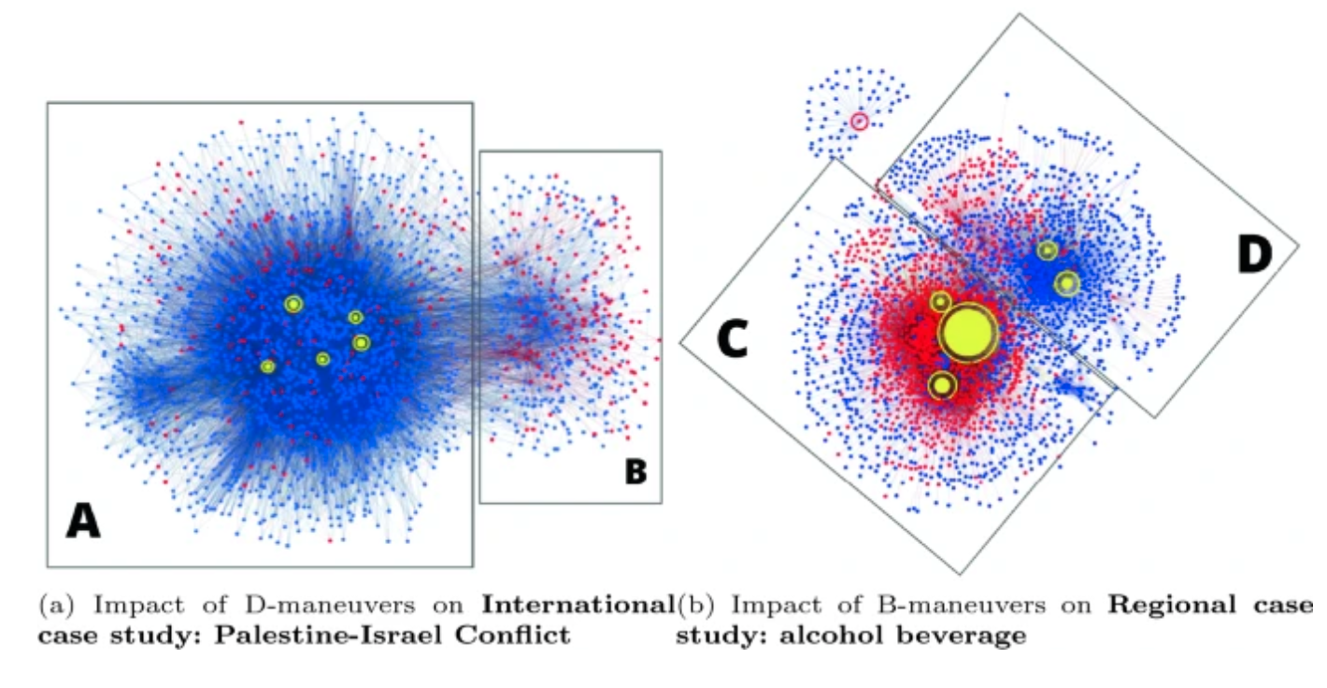
Information Manipulation Why do we care?
Polarizing Societies
“From curious hashtags to polarized effect: profiling coordinated actions in Indonesian twitter discourse” Social Network Analysis and Mining
Blue = Humans/ Red = Bots
Notes:
The next reason why we should care is that information manipulation can polarize societies. Here are two polarized networks from 2021 Indonesian discourse on controversial topics. This networks were the result after bot information manipulation.

Slide 21
Information Manipulation Why do we care?
Polarizing Societies
If you apply enough social pressure, you can segregate people into clusters (i.e., polarization, echo-chambers)
“From curious hashtags to polarized effect: profiling coordinated actions in Indonesian twitter discourse” Social Network Analysis and Mining
Blue = Humans/ Red = Bots
Notes:
This example shows that if you apply enough social pressure, you can segregate people into clusters. Each of the two clusters in the networks eventually turned into echo chambers, that post similar narratives as each other, but holding opposite views than the other cluster.

Slide 22
Information Manipulation How do we identify information campaigns?
Notes:
How do we identify information campaigns?

Slide 23
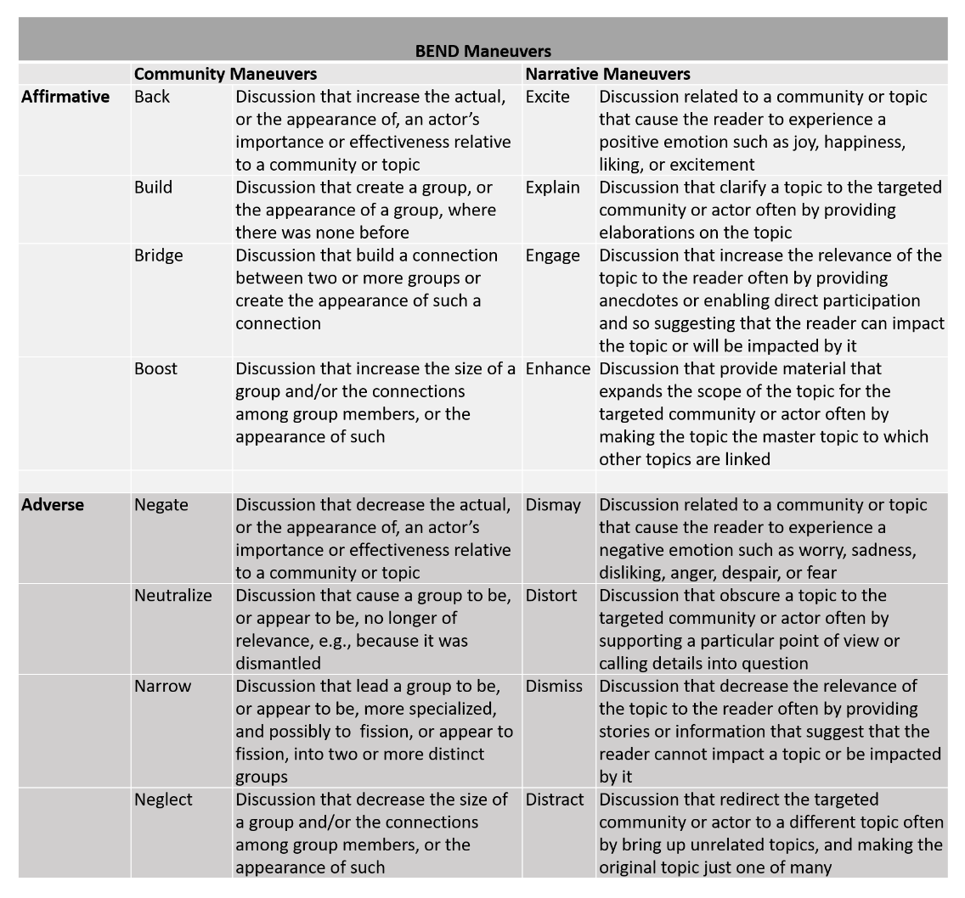
Information Manipulation How do we identify information campaigns?
BEND Framework
Information maneuvers comprised of narrative & community maneuvers
“Analyzing Digital Propaganda and the Conflict Rhetoric: A Study on Russian Bot Driven Campaigns and Counter Narratives During the Ukraine Crisis”
Notes:
One technique we use is the BEND framework. The framework puts forth at information maneuvers are comprised of narrative and community maneuvers. These maneuvers can be identified through linguistic cues from the posts, and network cues from the network. For example, the Excite maneuver is typically identified through positive words, exclamation marks and happy emojis. We use this framework because it provides a quantitative output towards measuring the extent of information campaigns in the network, so it returns a numerical value.

Slide 24
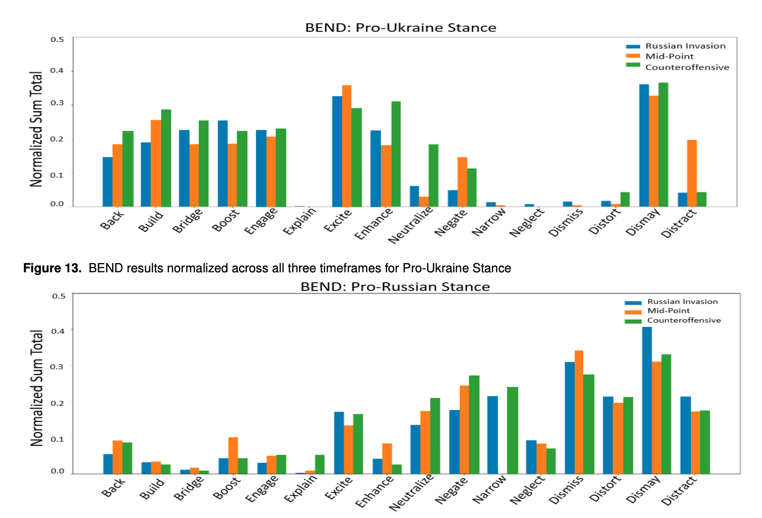
Information Manipulation How do we identify information campaigns?
2022 Russian Ukraine Campaign
“Analyzing Digital Propaganda and the Conflict Rhetoric: A Study on Russian Bot Driven Campaigns and Counter Narratives During the Ukraine Crisis”
Notes:
We ran the BEND framework across a large number of tweets discussing the 2022 Russian Ukraine Campaign

Slide 25
Information Manipulation How do we identify information campaigns?
2022 Russian Ukraine Campaign
Pro-Ukraine users consistently perform more positive techniques
“Analyzing Digital Propaganda and the Conflict Rhetoric: A Study on Russian Bot Driven Campaigns and Counter Narratives During the Ukraine Crisis”
Notes:
We saw that Pro-Ukraine users consistently perform more positive techniques.

Slide 26
Information Manipulation How do we identify information campaigns?
2022 Russian Ukraine Campaign
Pro-Ukraine users consistently perform more positive techniques
Pro-Russian users consistently perform more negative techniques
“Analyzing Digital Propaganda and the Conflict Rhetoric: A Study on Russian Bot Driven Campaigns and Counter Narratives During the Ukraine Crisis”
Notes:
While Pro-Russian users consistently perform more negative techniques. When we dug further into the tweet narratives, pro-Ukraine users tried to promote an image of patriotism, unity and love for the country. On the other hand, pro-Russian users tried to put down their enemies using negative narratives.

Slide 27
Information Manipulation How do we identify information campaigns?
Automated Coordination
Identifying groups of bots that coordinate
“Tiny-BotBuster: Identifying Automated Political Coordination in Digital Campaigns”
Green = Humans/ Red = Bots
Notes:
Another way of identification is through Automated Coordination.

Slide 28
Information Manipulation How do we identify information campaigns?
2024 Indonesian Election Campaigns
Three Largest Political Parties have clusters of online information campaigns using bots
“Tiny-BotBuster: Identifying Automated Political Coordination in Digital Campaigns”
Green = Humans/ Red = Bots
Notes:
When we studied the online conversations during the 2024 Indonesian Elections, we observe that the three largest political parties have clusters of online information campaigns. These campaigns greatly use bots. In the network graphs here, we show how these bots, that are coloured in red, are coordinated with each other to automate online campaigning. These coordination presents in terms of social and semantic coordination. Posts between users constantly contain similar user tags or hashtags.

Slide 29
Information Manipulation How do we identify information campaigns?
2024 Indonesian Election Campaigns
Largest party (PDI-P) used the most % of bots
“Tiny-BotBuster: Identifying Automated Political Coordination in Digital Campaigns”
Green = Humans/ Red = Bots
Notes:
Not surprisingly though, the largest party used the most percentage of bots

Slide 30
Information Manipulation WHO is manipulating information?
Notes:
Now, Who is manipulating information?

Slide 31
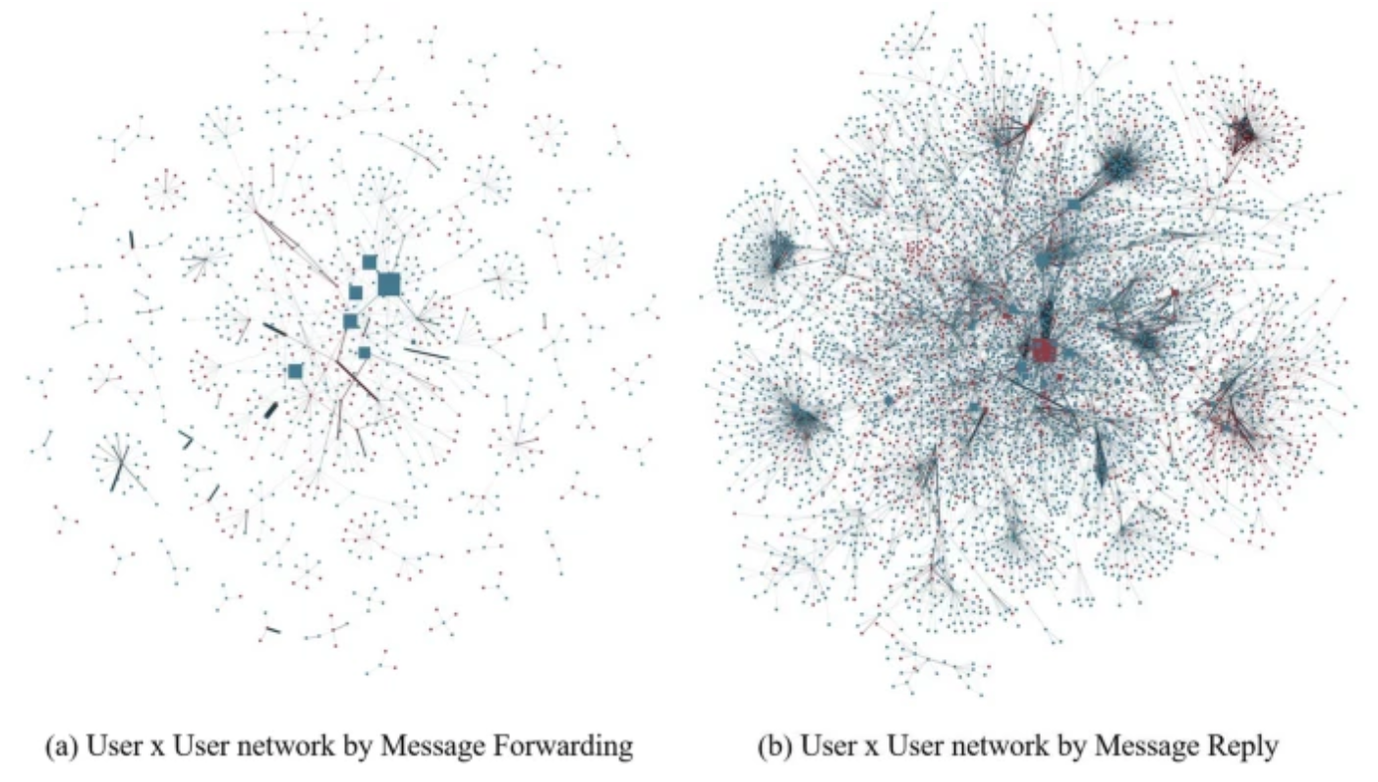
Information Manipulation WHO is manipulating information?
COVID disinformation on Telegram
“An Exploratory Analysis of COVID bot and human disinformation dissemination from the Disinformation Dozen on Telegram” Journal of Computational Social Science
Green = Humans/ Red = Bots
Notes:
Let’s look at the conversation of COVID disinformation on Telegram. We collected data from Telegram channels of the Disinformation Dozen, which is group of 12 people that the US media said were spreading disinformation. We also collected data from the channels where the disinformation was forwarded to.
Then we formed two network graphs. In the left network, the nodes are users and they are connected by message forwarding action. So if user A forwards user B’s message, the two users A and B are connected.
In the right network, the user nodes are connected by message replies. So if user A replies to user B, the two users A and B are connected. The nodes are also sized by centrality value, indicating the influence of the nodes.

Slide 32
Information Manipulation WHO is manipulating information?
COVID disinformation on Telegram
Bots keep conversation alive (replies)
Humans create and spread narratives (forwards)
“An Exploratory Analysis of COVID bot and human disinformation dissemination from the Disinformation Dozen on Telegram” Journal of Computational Social Science
Green = Humans/ Red = Bots
Notes:
We see more bots of influence, which are red colour, in the right network, while we see more humans in the left network. Generally, bots keep conversation alive, while humans create and forward disinformation narratives. Although humans are the key thrusts of spread, bots bump the disinformation at the top of the feed with their continuous activity.

Slide 33
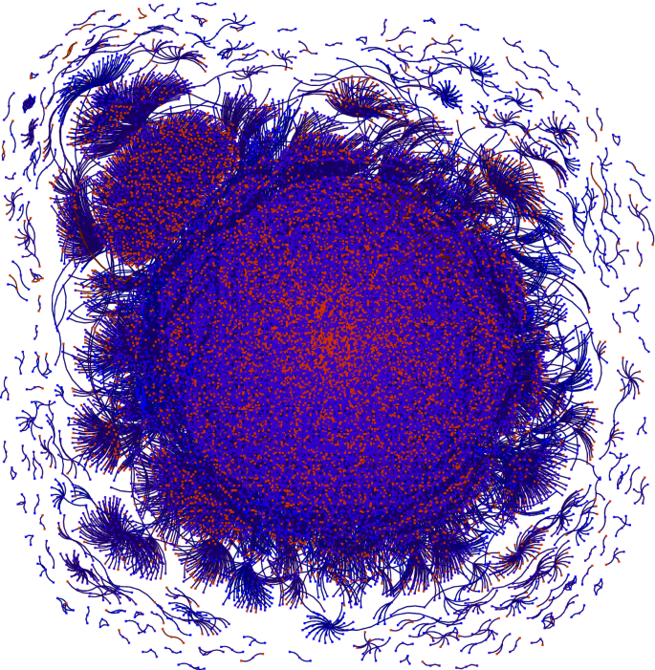
Information Manipulation WHO is manipulating information?
2020 Singapore Elections
Bots are embedded in conversation
“Active, Aggressive but to No Avail: Characterizing Bot Activity during the 2020 Singaporean Elections” Computational and Mathematical Organization Theory
Green = Humans/ Red = Bots
Notes:
We see a similar pattern with the 2020 Singapore Elections on Twitter. This time, we see a very interconnected conversation, where bots are embedded within, and have communication with the human users.

Slide 34
Information Manipulation WHAT narratives are being spread?
Notes:
Next up, What narratives are being spread?

Slide 35
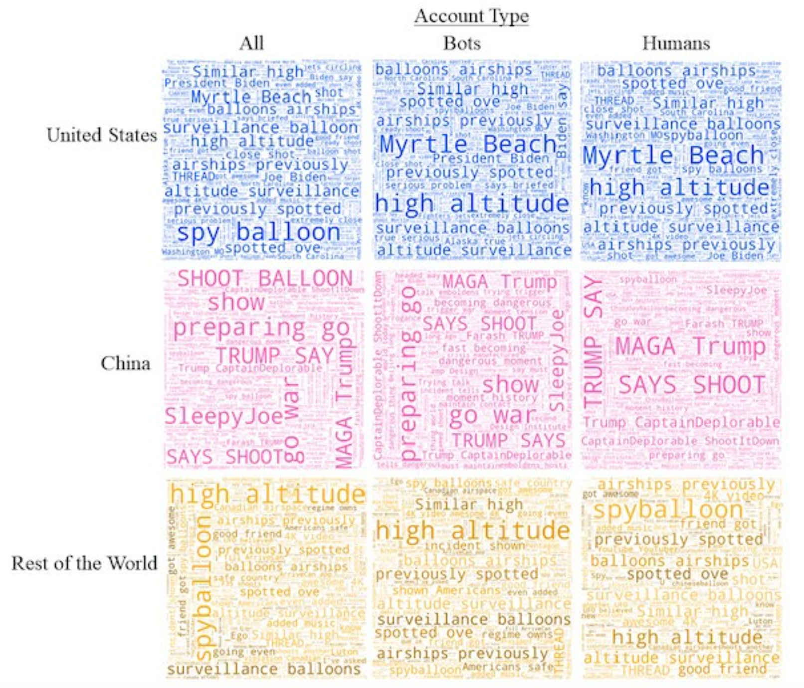
Information Manipulation WHAT narratives are being spread?
2023 US-China Balloon Incident
Bots exaggerate narratives spread by humans
“Deflating the Chinese Balloon: Types of Twitter Bots in the US-China balloon incident” EPJ Data Science
Notes:
In this slide, we used topic modeling to extract and group topics within the 2023 US-China Balloon Incident. In that incident, US discovered a balloon that belonged to China in its airspace. Throughout these categories, which are based on the profiling of user locations, we see that bots exaggerate narratives spread by humans. For example, Humans will say shoot balloon, while Bots will say go war. Humans will say spy balloon, while bots will emphasize on the surveillance aspect.

Slide 36
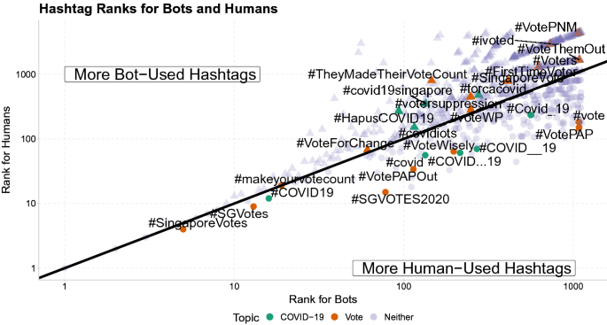
Information Manipulation WHAT narratives are being spread?
2020 Singapore Elections
Bots Call for Action
“Active, Aggressive but to No Avail: Characterizing Bot Activity during the 2020 Singaporean Elections” Computational and Mathematical Organization Theory
Notes:
Closer to home, in the 2020 Singapore Elections, when we compare the hashtags that are more used by humans vs the hashtags that are more used by bots, we see that bots typically create a call to action. Where humans say Vote Wisely, the bots exaggerate it to Vote for change, or vote them out

Slide 37
Information Manipulation WHEN are narratives spread?
Notes:
When are narratives spread?

Slide 38
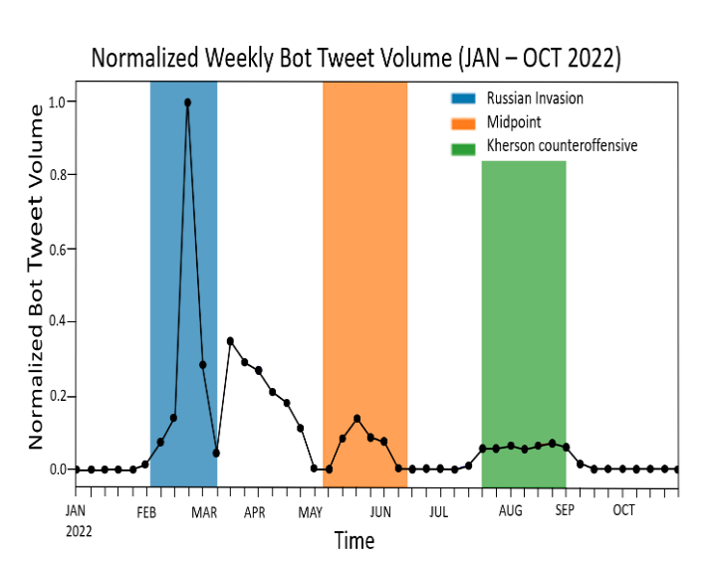
Information Manipulation WHEN are narratives spread?
2022 Russia Invasion of Ukraine
Spikes in tweet volume during key points of the invasion
In between key points, the bots maintain activity at lower rate
“Analyzing Digital Propaganda and the Conflict Rhetoric: A Study on Russian Bot Driven Campaigns and Counter Narratives During the Ukraine Crisis”
Notes:
Narratives are usually spread during key events. In the discourse on X on the 2022 Russia Invasion of Ukraine, we see spikes in tweet volume from bots during key points of the invasion. In between key points, the bots maintain activity at a lower rate.

Slide 39
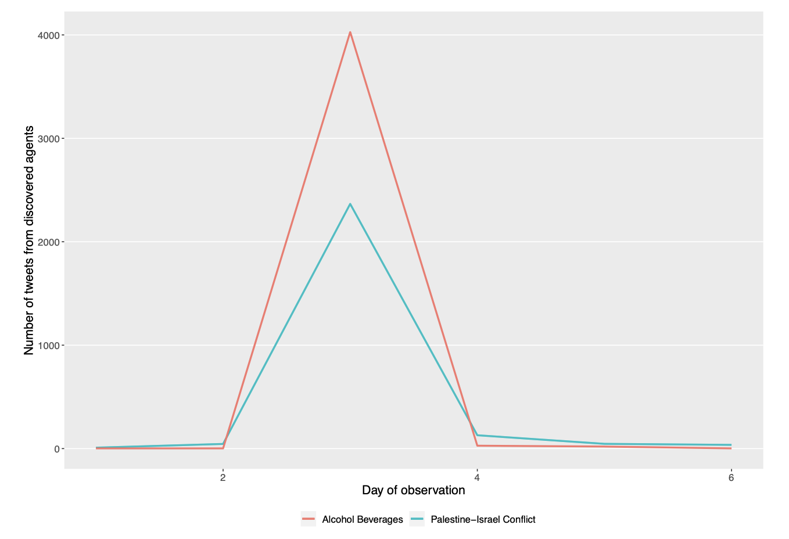
Information Manipulation WHEN are narratives spread?
2021 Indonesian Discourse
Spikes in tweet volumes by bot accounts on the days of key announcements
“From curious hashtags to polarized effect: profiling coordinated actions in Indonesian twitter discourse” Social Network Analysis and Mining
Notes:
A similar pattern occurred in the 2021 Indonesian Discourse. In two different sets of events, there are spikes in tweet volumes by bot users on the days of key announcements.

Slide 40
Information Manipulation WHERE are narratives targeting?
Notes:
Where are the narratives targeting?

Slide 41
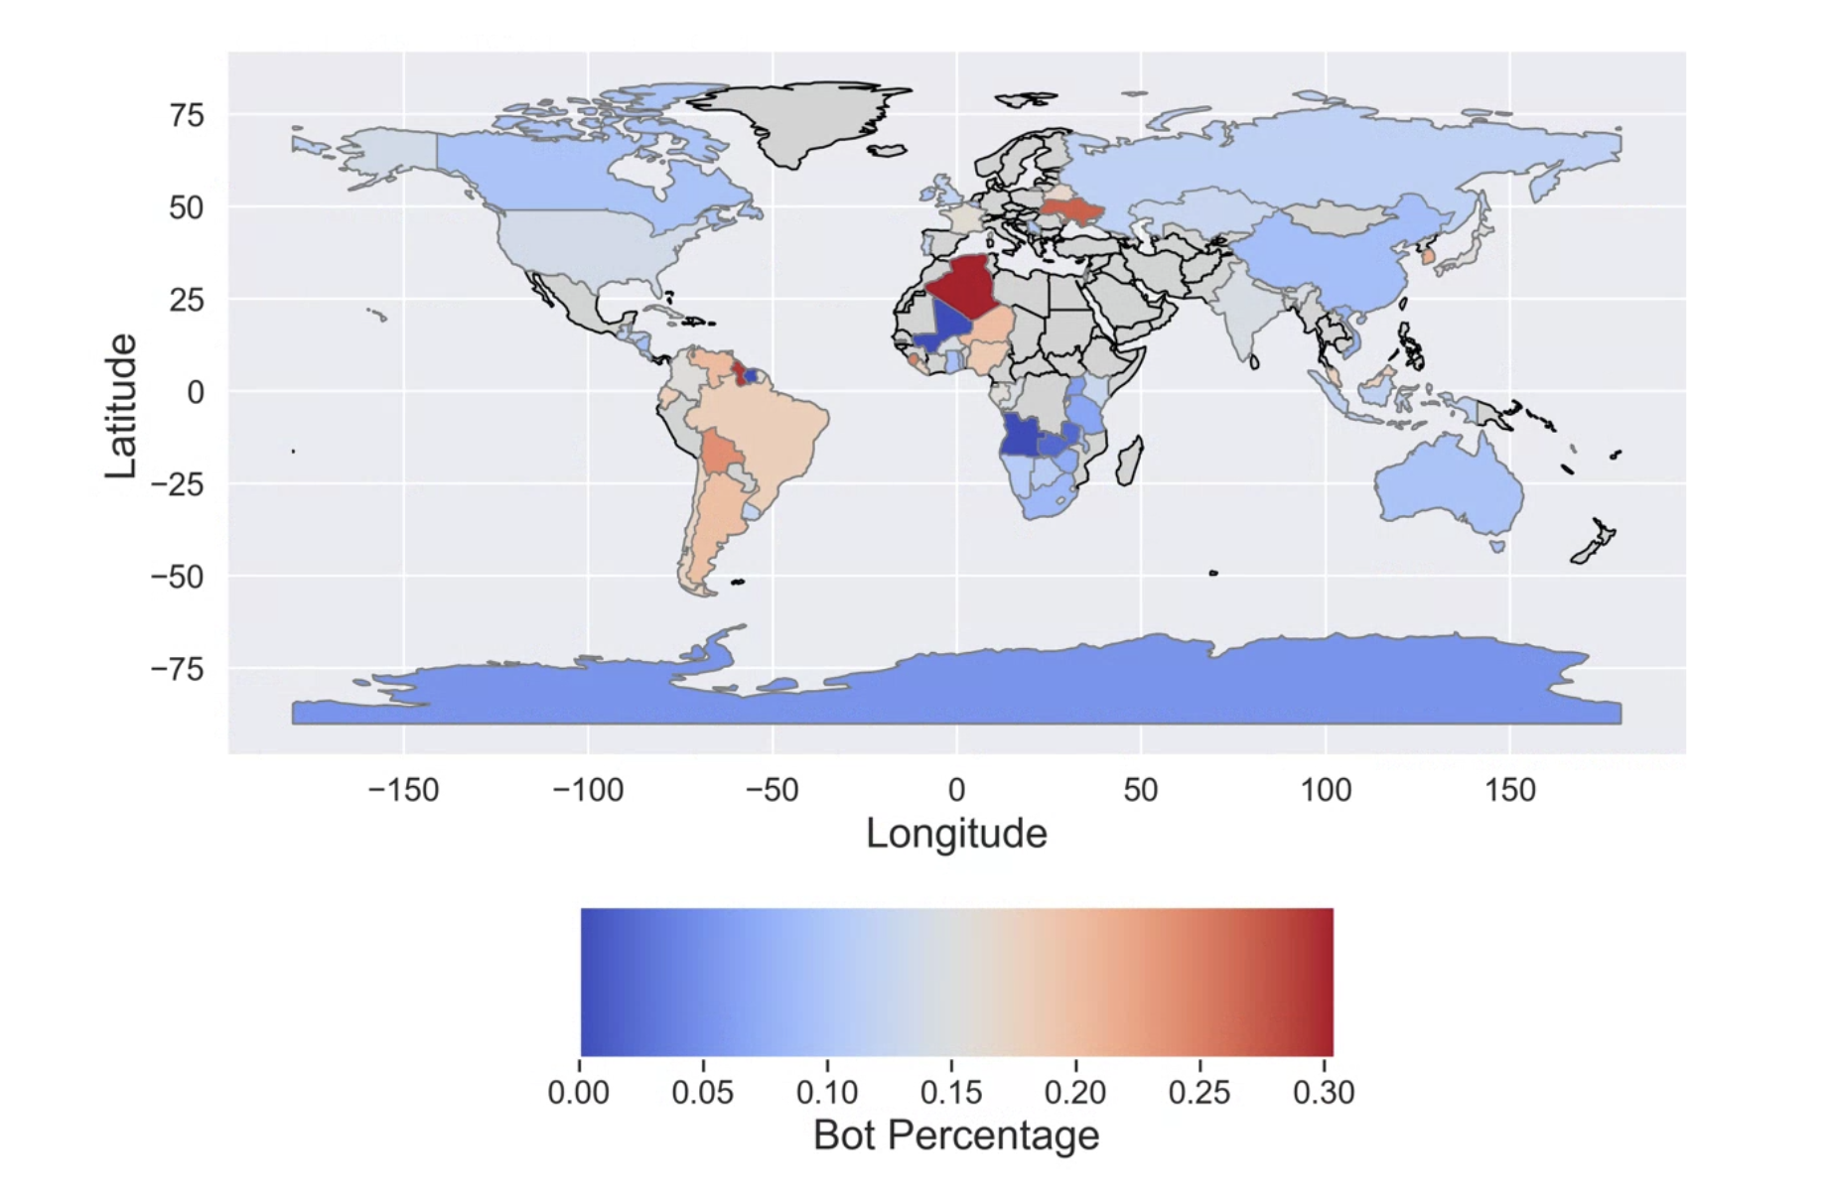
Information Manipulation WHERE are narratives targeting?
COVID data 2020-2021
Bots are present all around the globe
Notes:
We used 12 months of COVID-19 data from X to plot this graph. This graph shows the declared location of the users, if any. The graph shows that bots are present all around the globe.

Slide 42
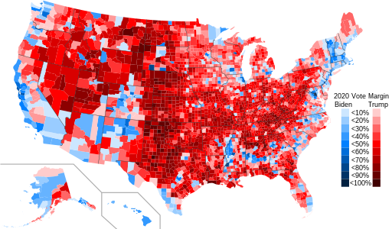
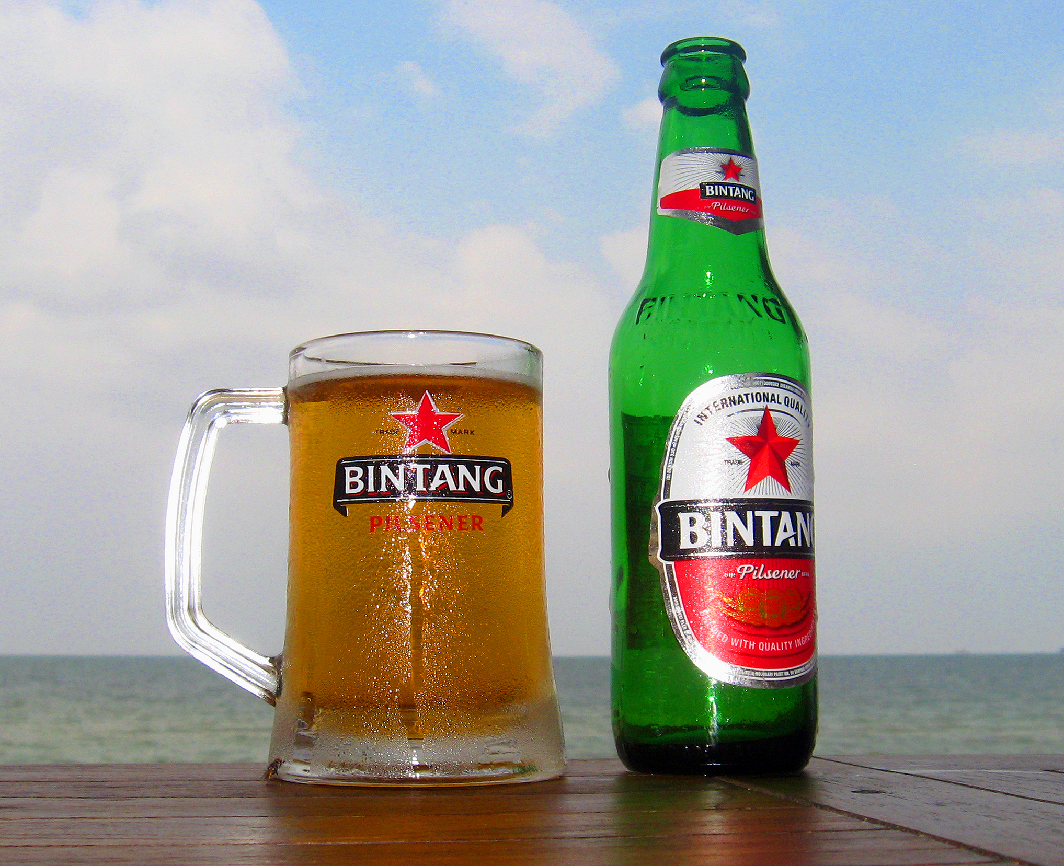
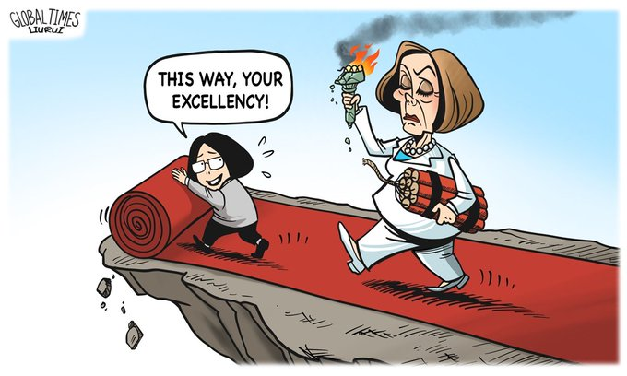
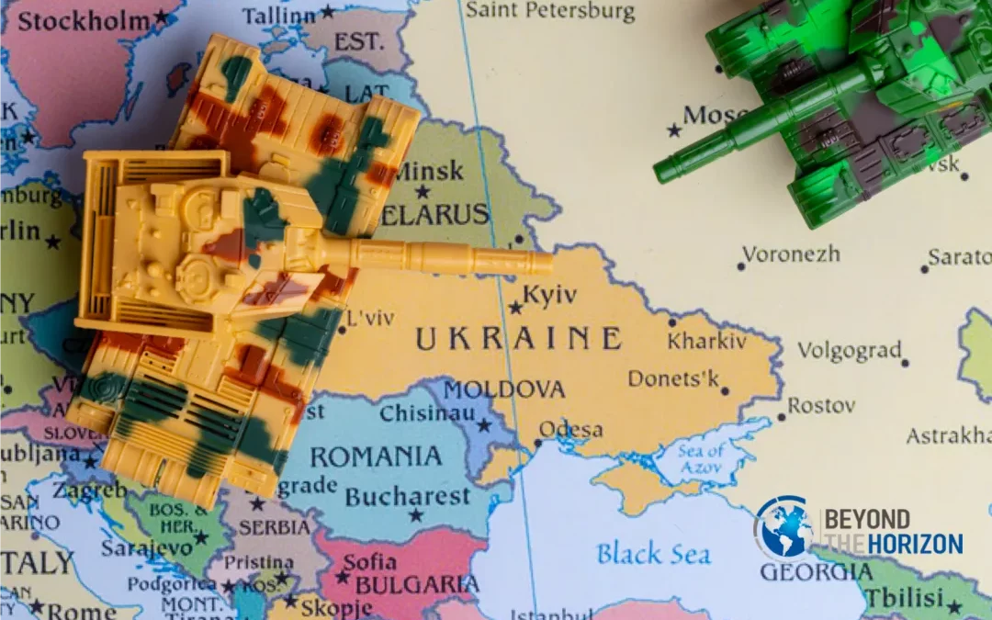
Information Manipulation WHERE are narratives targeting?
2020 US Elections
2020 Brexit
2021 Indonesian Alcohol Beverages/ Palestine-Israel discourse
2022 Nancy Pelosi Visit to China
2023 US-China Balloon Incident
2023 Russia-Ukraine Conflict
Notes:
Academic work, including many work presented in this talk, have demonstrated the use of bots for information manipulation throughout a variety of events, ranging from elections to domestic and international conflict.

Slide 43
Information Manipulation WHERE are narratives targeting?
2020 US Elections
2020 Brexit
Topics that can divide society
2021 Indonesian Alcohol Beverages/ Palestine-Israel discourse
2022 Nancy Pelosi Visit to China
2023 US-China Balloon Incident
2023 Russia-Ukraine Conflict
Notes:
In essence, bots are targeting topics that can divide society.

Slide 44
Information Manipulation Summary of Bot Activity
WHY
Changing people’s stances,
Polarizing Societies, Stance Convergence
HOW
BEND Framework,
Automated Coordination
WHO
Bots keep conversation alive
Humans create and spread narratives
WHAT
Bots exaggerate human-created narratives
Call for Action
WHEN
Key Events
WHERE
All around the globe
Topics that can divide society
Notes:
In this talk, we talked about the Who what when where why and how of information manipulation on social media.

Slide 45
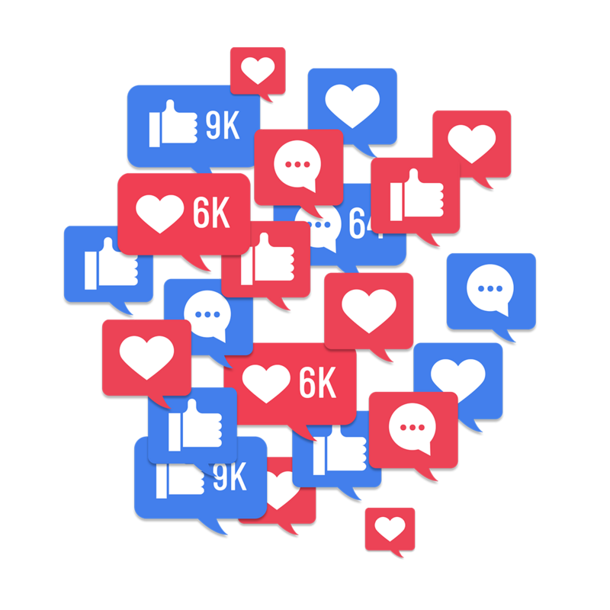
Information Manipulation Simulation as a predictive tool
WHO
Bots/ Humans
WHAT
Narratives
HOW
Create Posts
BEND Framework
Automated Coordination
WHY
Perform Information Manipulation
Change engagement
Create polarization
WHERE
Analyze Impact
Virtual Experiments
WHEN
Time Series Analysis
Notes:
I’ve presented an overview of information manipulation by social media bots, now what’s next? The next research direction involves simulation as a predictive tool. The social media landscape is a live system, and therefore for ethical reasons we should not alter the environment.
Therefore, we create a simulated system, using empirical data and set ups that models the live system. In this system, we combine all the elements of the 6W1H that we examined earlier. We begin with WHO, which we create AI agents that mimic bots/ humans. That create posts, perform information manipulation, and then we analyze the impact. We do virtual experiments across a time series analysis.

Slide 46
Information Manipulation Simulation as a predictive tool
WHO
Bots/ Humans
Profiling Information Campaigns
What is the impact of a campaign with a set of input parameters?
WHAT
Narratives
HOW
Create Posts
BEND Framework
Automated Coordination
WHY
Perform Information Manipulation
Change engagement
Create polarization
WHERE
Analyze Impact
Virtual Experiments
WHEN
Time Series Analysis
Notes:
This simulation has two key questions to be answered. First, profiling information campaigns: what is the impact of a campaign with a set of input parameters? That targets the WHY part - knowing the impact, which will give us clarity for predicting the impact of information manipulation in the real life scenarios.

Slide 47
Information Manipulation Simulation as a predictive tool
WHO
Constructing Information Campaigns
What narratives, and how should I propagate them to achieve a desired impact? Who is more effective?
Bots/ Humans
WHAT
Narratives
HOW
Create Posts
BEND Framework
Automated Coordination
WHY
Perform Information Manipulation
Change engagement
Create polarization
WHERE
Analyze Impact
Virtual Experiments
WHEN
Time Series Analysis
Notes:
The second question is on constructing information campaigns. There, we ask, what narratives, and how should i propagate them to achieve a desired impact? Who is more effective? This targets WHO WHAT HOW, and helps us understand how to create -information campaigns for public messaging and strategic communications purposes.

Slide 48
Combatting Information Manipulation
Multi-Pronged Approach
Government, Industry, Academia
Notes:
Social media is prime ground for information campaigns, especially automated campaigns. The power of information dissemination through social media is in harnessing the ability to propagate information fast and wide, and in large quantities. Automated campaigns can reach beyond geographical boundaries, and have great offline impact. Therefore, combatting information manipulation is a multi- pronged approach that requires close collaboration between the government, industry and academia to detect, analyze and predict the campaigns, and create counter-maneuvers and policies to preserve our digital health.

Slide 49
Information Manipulation by Social Media Bots through a Network Analysis View
Lynnette Hui Xian Ng
Website: quarbby.github.io
Notes:
Once again, my name is Lynnette Ng. I’ve presented an overview of information manipulation by social media bots, and some directions for future research. If you would like more information, or would like to discuss about the topics in depth, I would be very happy to talk to you. Thank you very much for listening.

